Slide 1

LOLMOVIES.com
LOLMOVIES.com
The Best Comedy movies.
DBMS Final Assignment | Michal Berkheim, Michal Lahav, Reshit Carmel | 2025

Slide 2

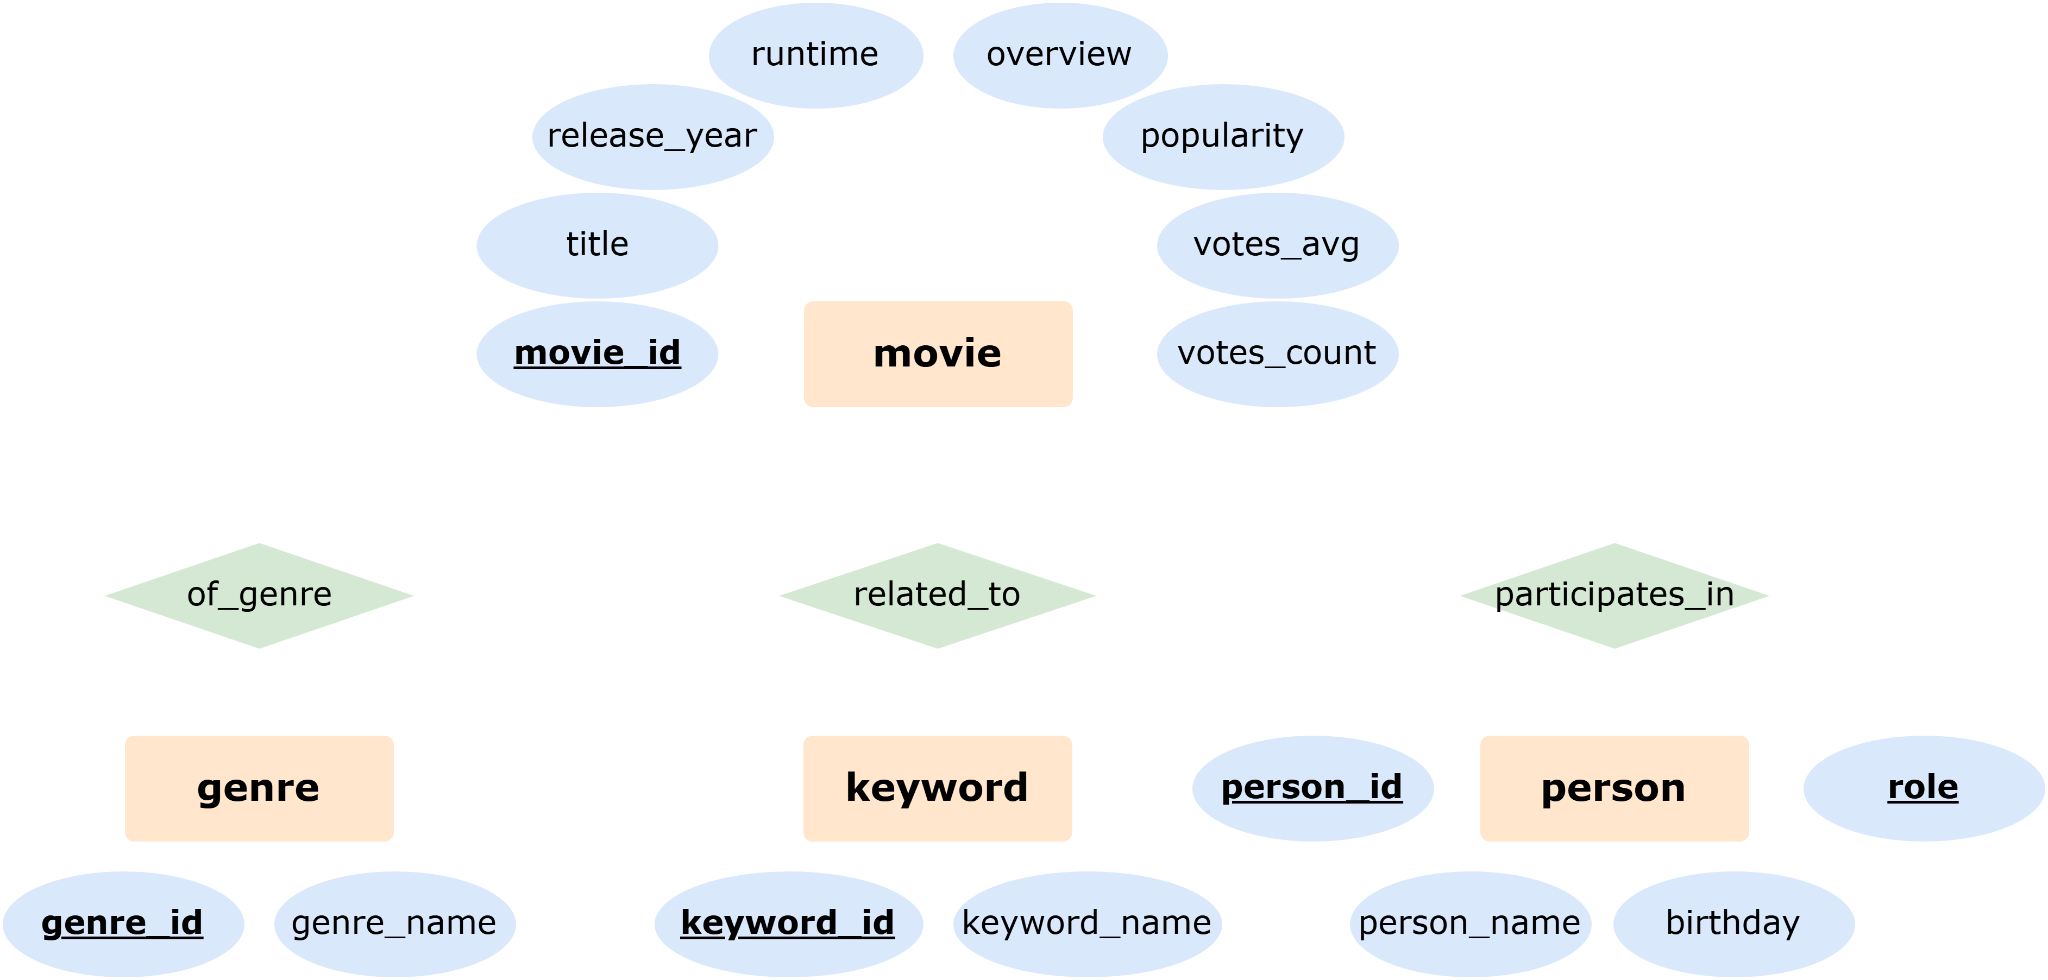
LOLMOVIES.com DBMS ER Diagram

Slide 3




LOLMOVIES.com Main Webpage
The 1000 top-rated full-length comedy movies of all times in the US, English Language, sorted by popularity

Slide 4




LOLMOVIES.com Q1: FULLTEXT Search – Title\Overview
⌕ love
“love” in overview
“love” in title

Slide 5




LOLMOVIES.com Q2: FULLTEXT Search – keyword
⌕ magic

Slide 6
LOLMOVIES.com Q3: Highest rated movie for a given director
⌕ Christopher Nolan

Slide 7
LOLMOVIES.com Q4: Actor\Year\Movies per Genres
⌕ Tom Hanks

Slide 8
LOLMOVIES.com Q5: Hidden Gems
⌕ Tom Hanks

